Slide 1
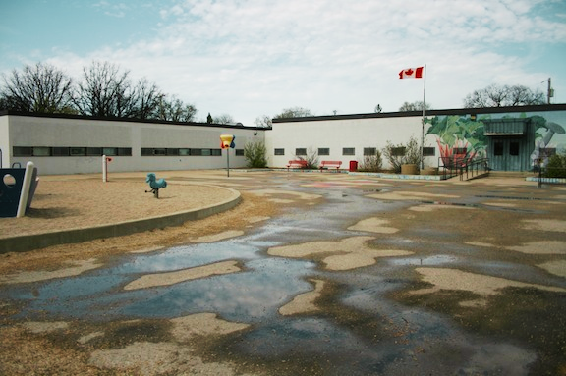
Welcome to Kindergarten
at École Varennes

Slide 2



I am starting school this year.
In September I start Kindergarten - Maternelle!
My school is École Varennes.

Slide 3
Some kids take the bus to get to school.
Kids on the bus sit nicely on their seat and listen to the driver. It is not safe to stand on the bus.

Slide 4
Some kids get dropped-off at school, by an adult from home or from daycare.

Slide 5
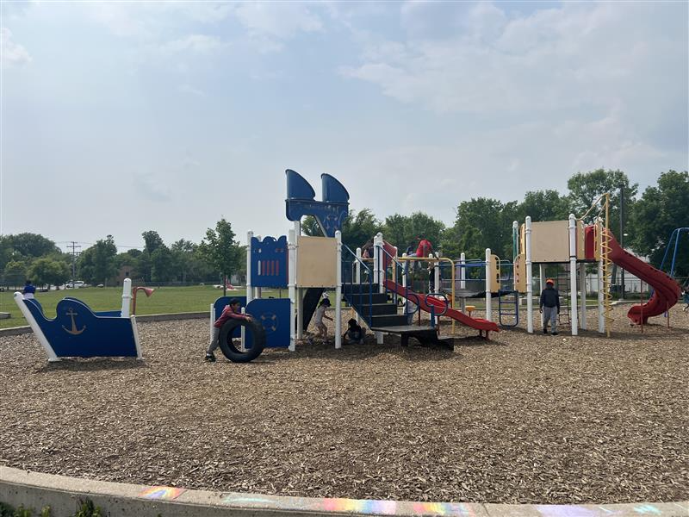

When I get to school, I can play in the school yard and play on the structure until the bell rings.

Slide 6
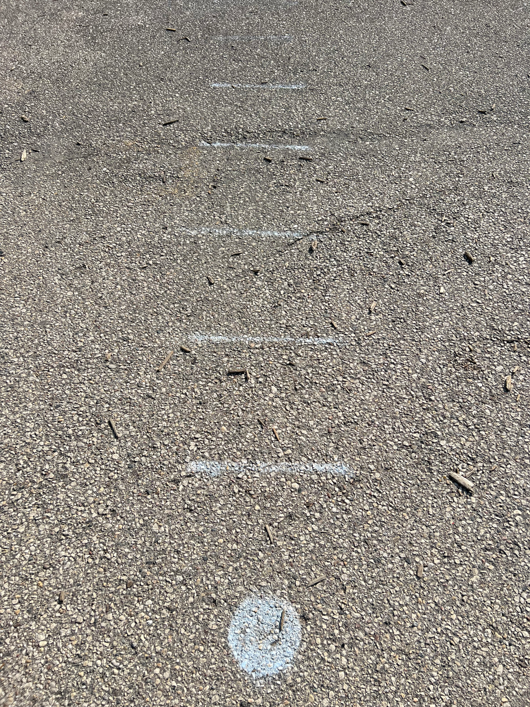
When the bell rings, I will line up with my class.
My line is marked on the ground.
I will look for my new teacher.

Slide 7
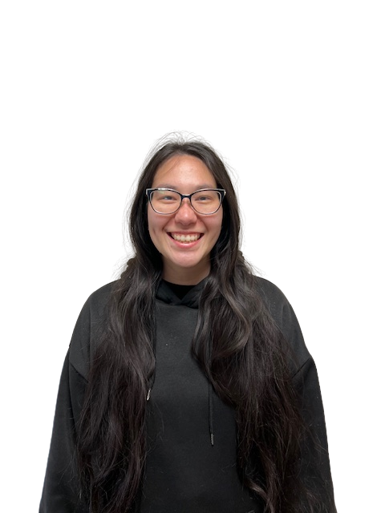
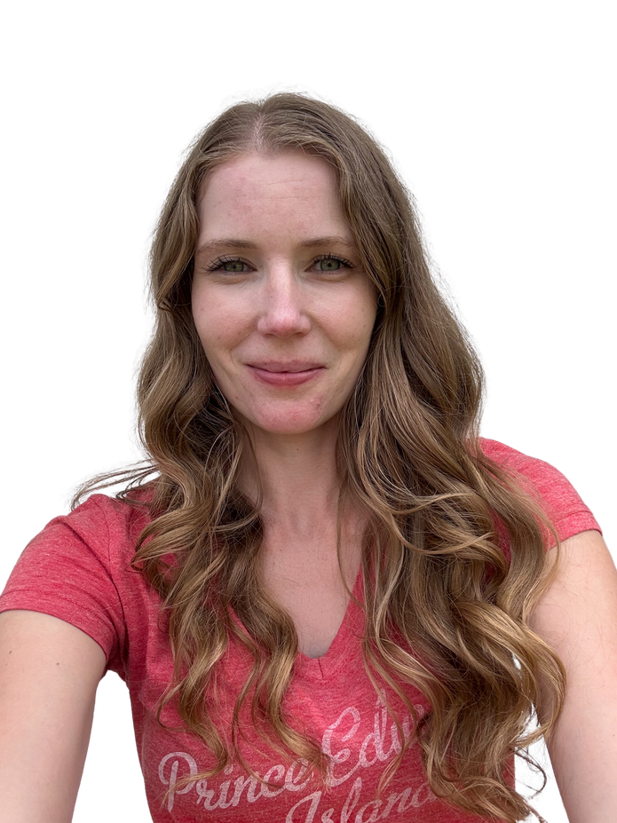
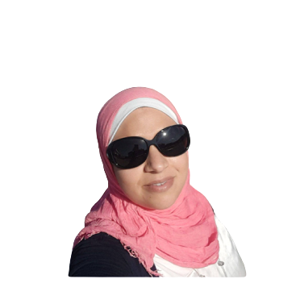
These are our kindergarten teachers.
They are very nice and are excited to see me at school! My teacher
Bonjour!
Mme Wai
Mme Jill
Mme Nihad

Slide 8
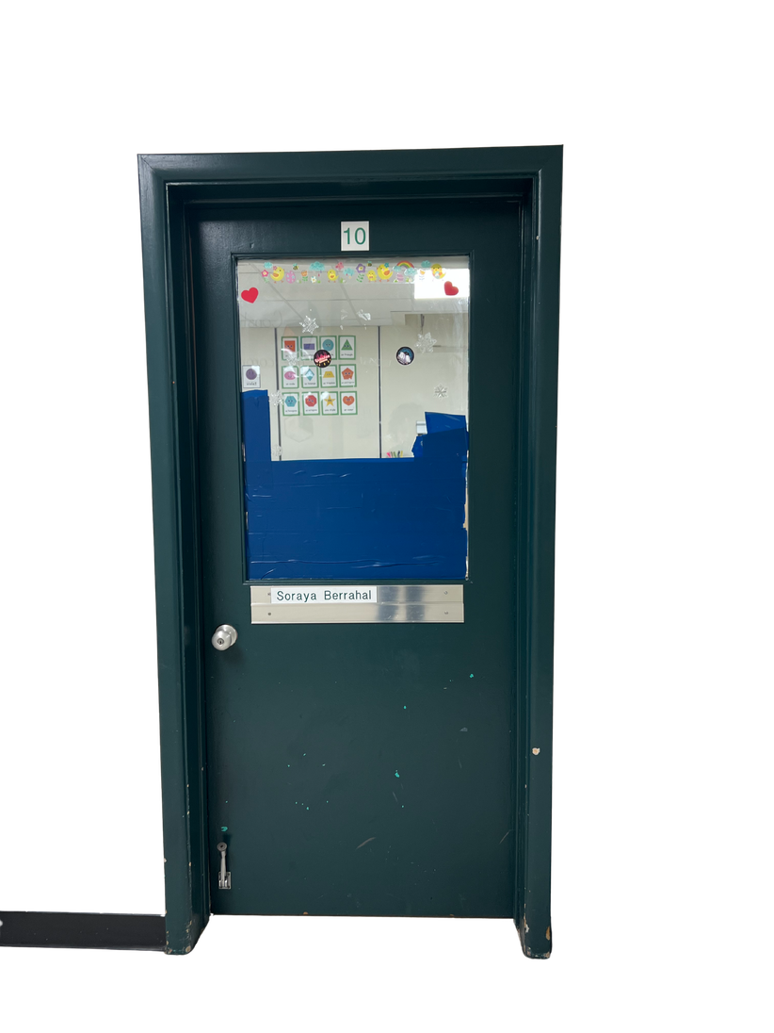
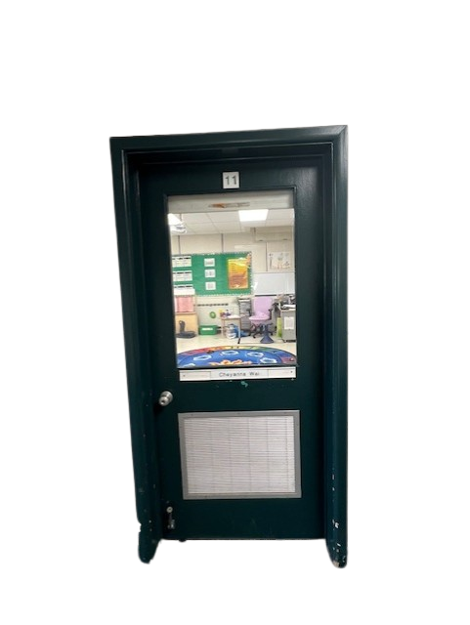
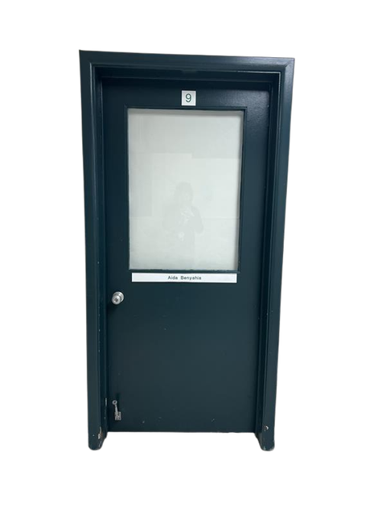
The kindergarten classrooms are:
Mme Wai - Room 11
Mme Jill - Room 8
Mme Nihad - Room 9

Slide 9
In my classroom, I listen to my teacher and the adults.
I am ready to learn!

Slide 10
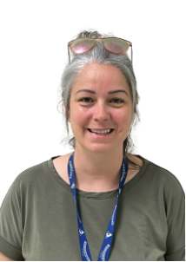
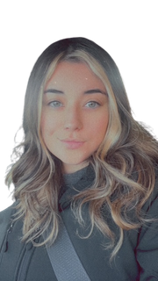
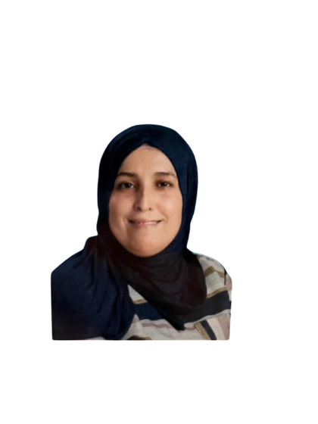

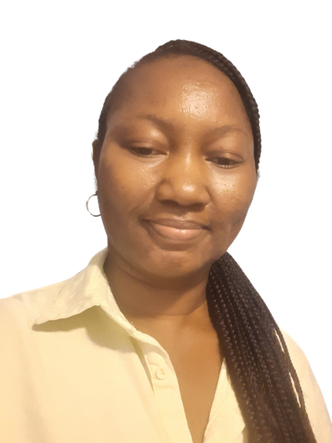
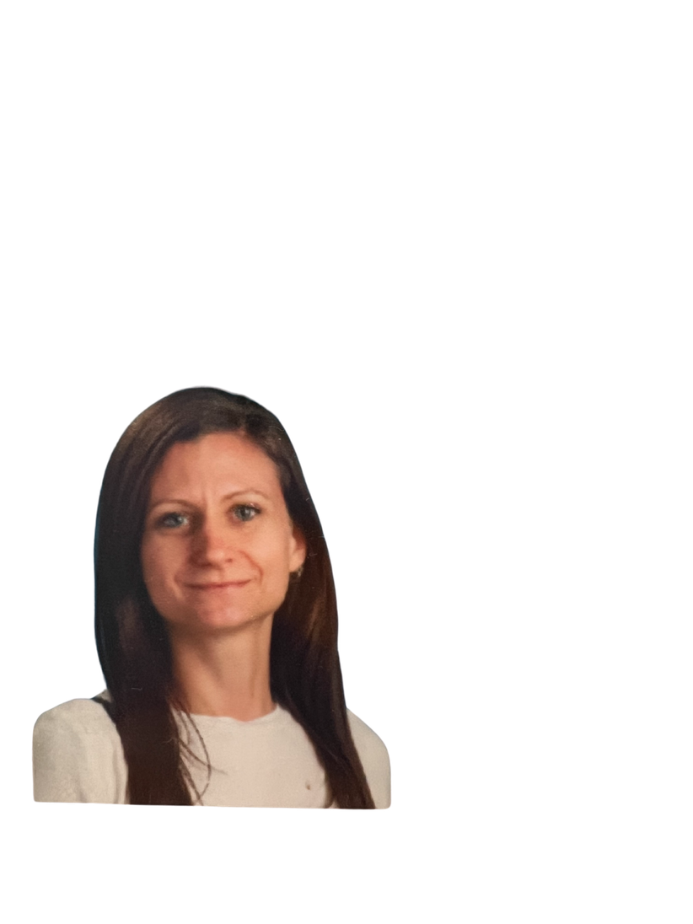
Some of the adults that will help outside and
in my classroom are:
Mme Khadidja
Mme Denise
Mme Taylor
M. Sam
Mme Belinda
Mme Arlene

Slide 11
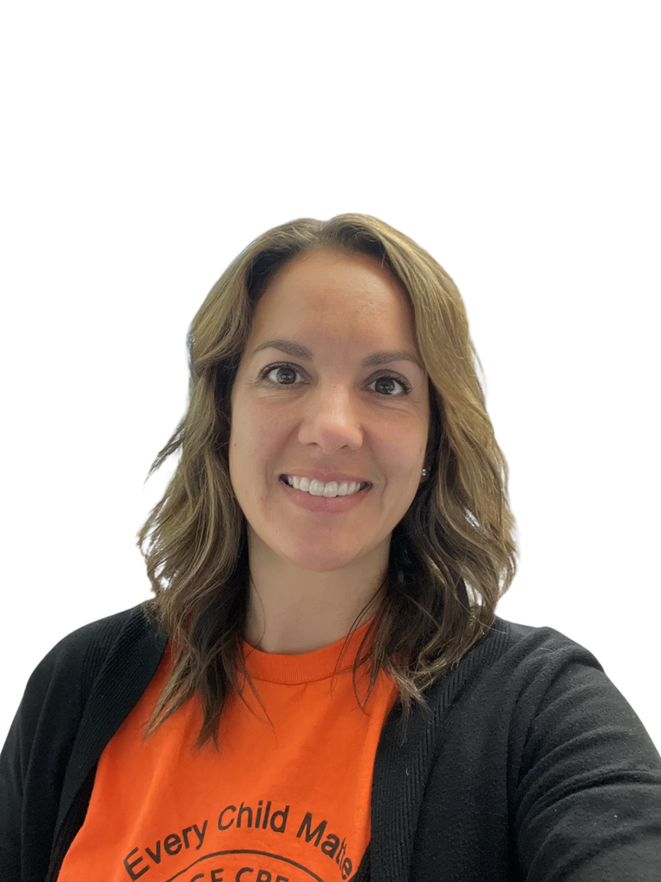
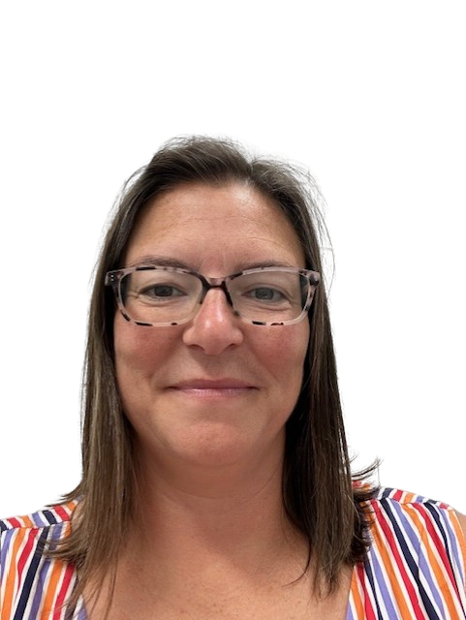
Our principal is
Mme Kennedy
Our vice-principal is
Mme Sheldon

Slide 12
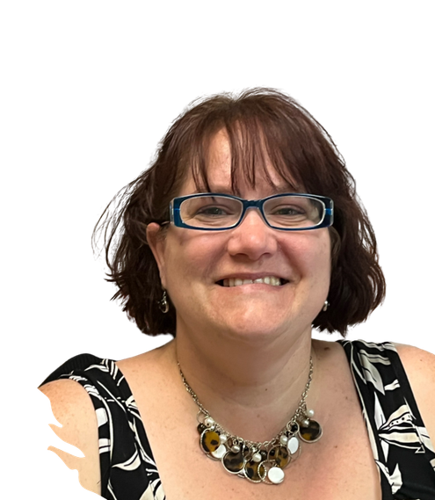
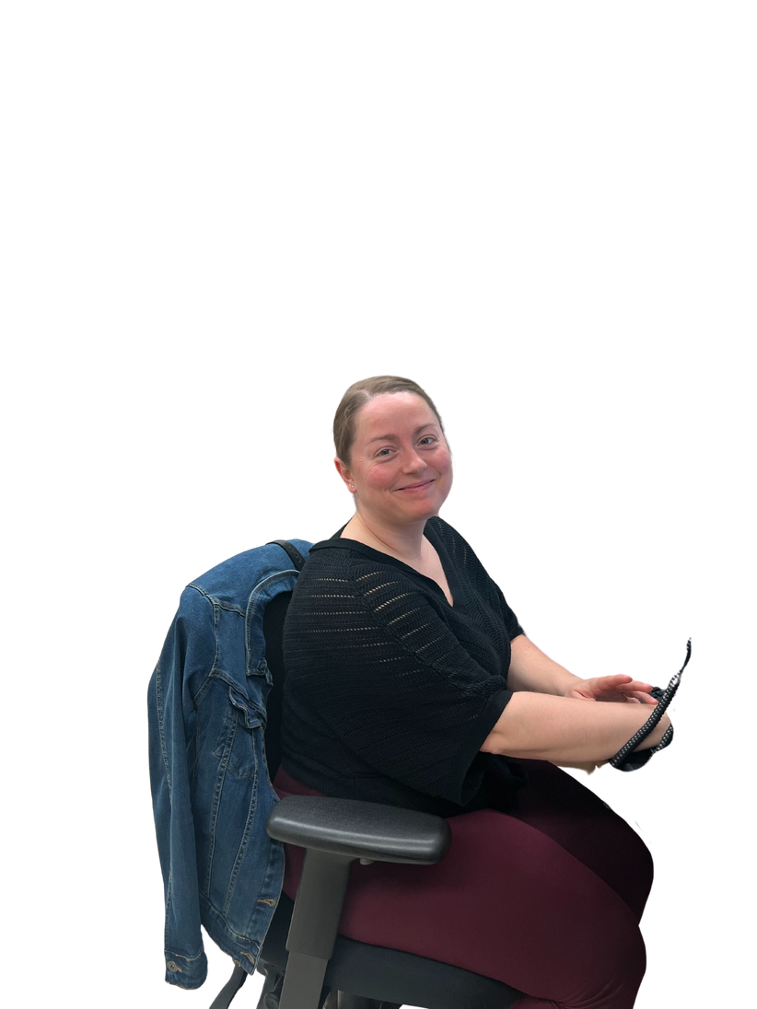
Our secretaries are:
Mme Danielle
Mme Stephanie
They are always there to help me if I get lost or need a bandaid!

Slide 13
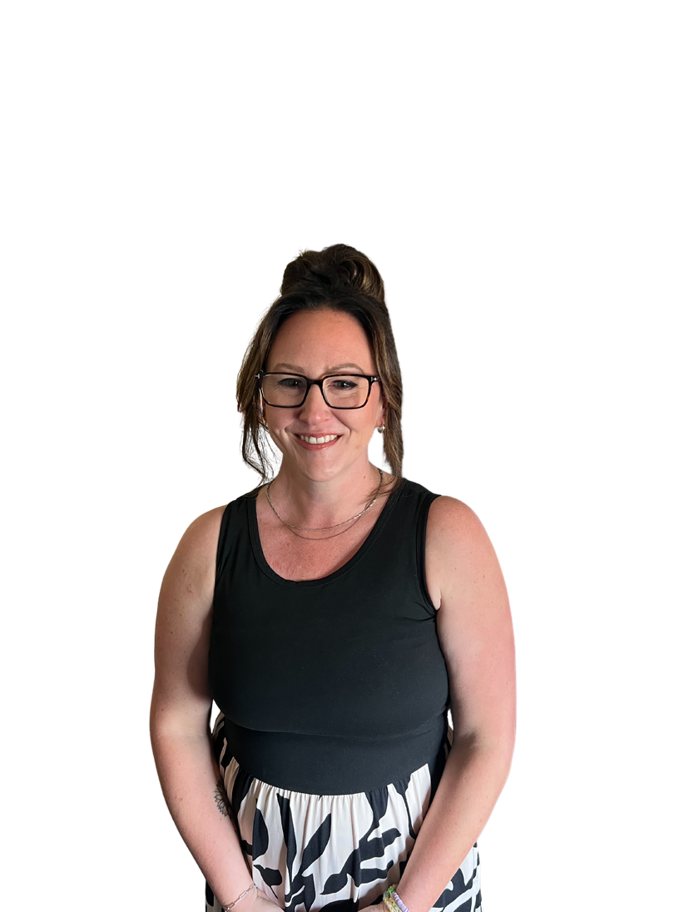
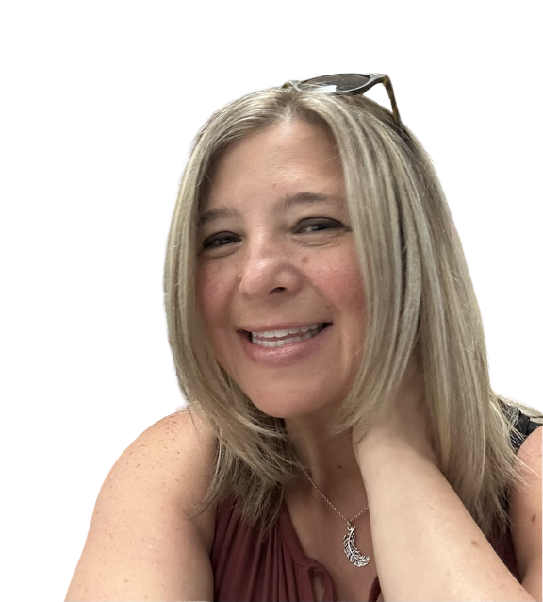
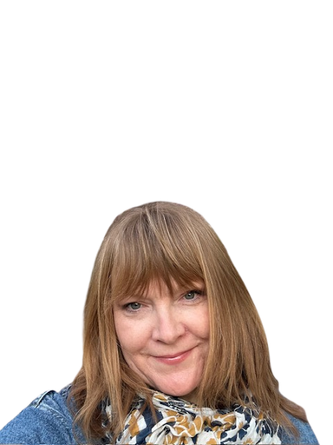
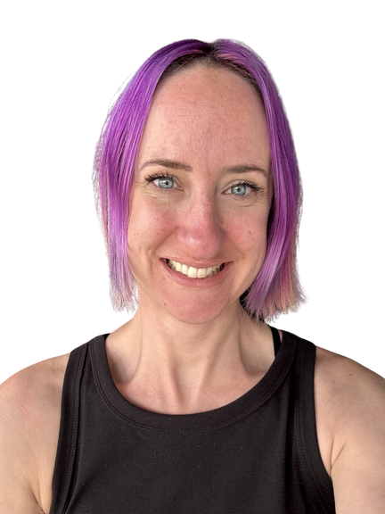
This is the student services team!
We help teachers and students in the classroom or in small groups.
Mme Benning
Mme Brownridge
Mme Legal
Mme Machutchon
You may see them in your classroom or in the hallway at school next year.

Slide 14
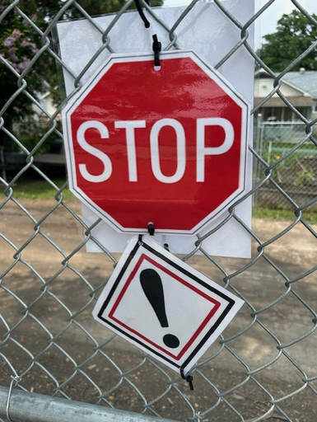
We get to play outside at recess. At recess we remember to stay in the school grounds. The fence has signs to remind us to never leave. Adults are outside to help us at recess. They wear bright vests so you can find them.

Slide 15
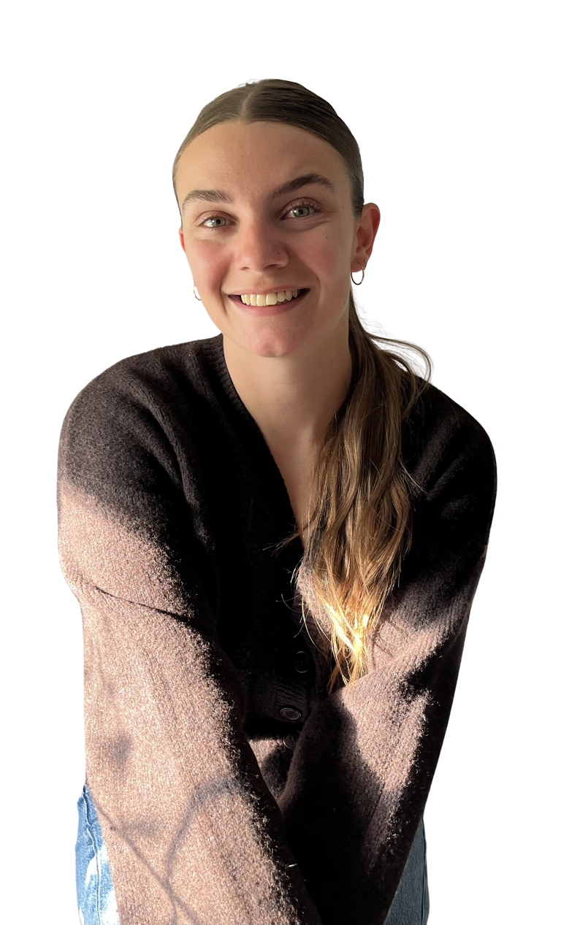


The gym teachers are M. Fiola and Mme Bérard.
They will teach us in the gym or outside!

Slide 16

The music teacher is Mme Boettcher.
In music we will learn songs, rhythm and dances.

Slide 17
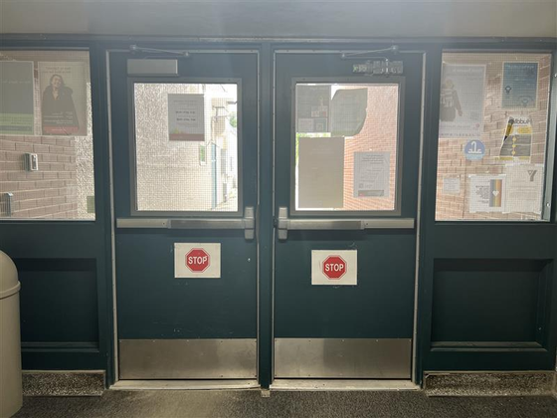
At school it is important to tell an adult
when you need to leave the room. ​​
It is also important to STOP when I see a stop sign,
these help keep me safe!

Slide 18
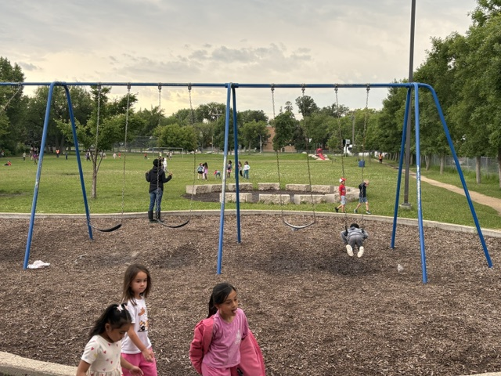

At the end of the day, I will be picked-up in the school yard. My parents will wait near the swings for me to come out with my teacher. I have to stay with my teacher until my adult comes to get me or until I get on the bus.

Slide 19
I will have a lot of important jobs to do at school.
I will have a lot of adults here to help me too!
*Please add a picture of your
kindergarten student here!
I will have a lot of fun and I will learn so many new things in Kindergarten at École Varennes!

