Slide 1
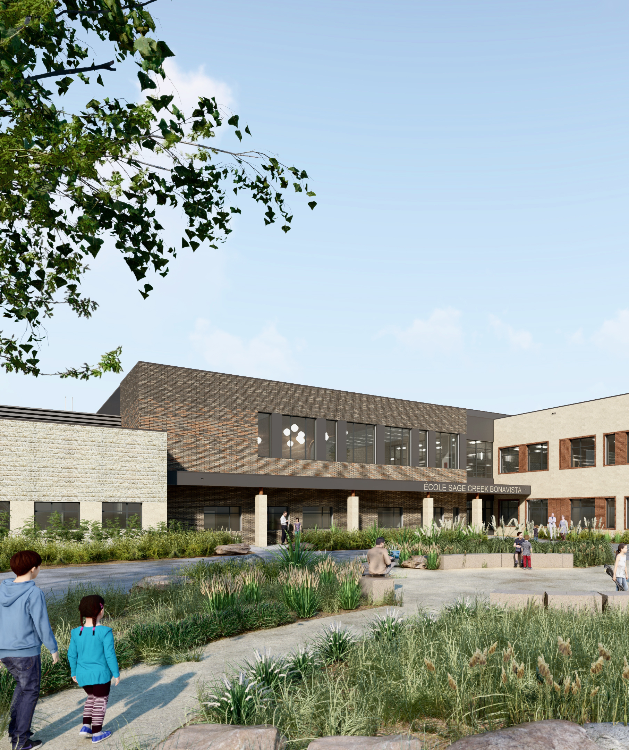
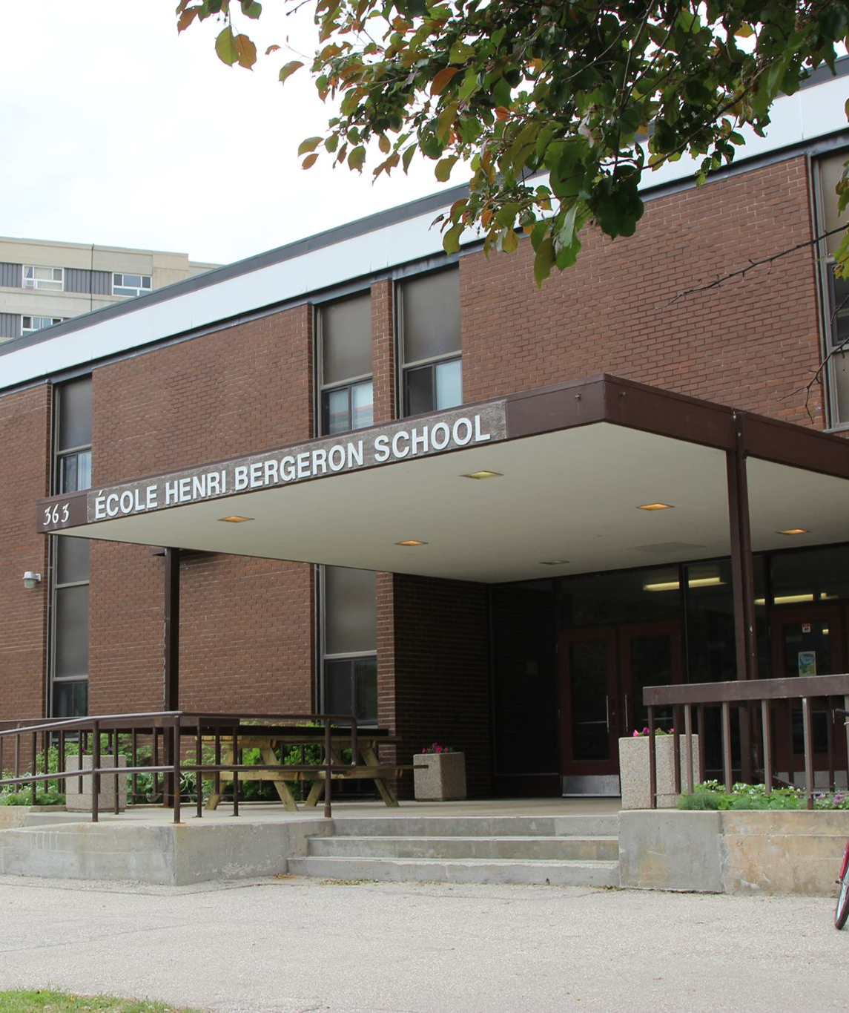
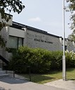
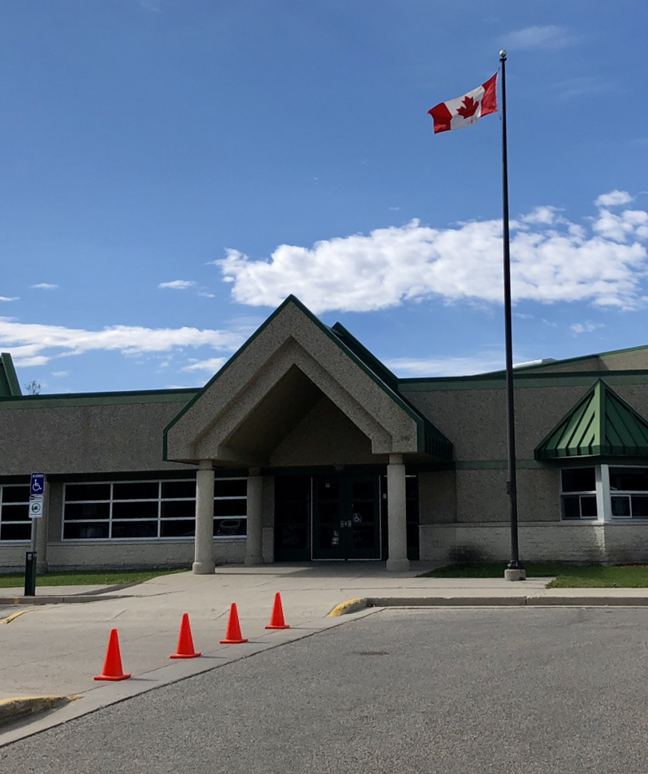
Louis Riel School Division Middle and late Immersion information Evening
2026
Notes:
Jeff

Slide 2
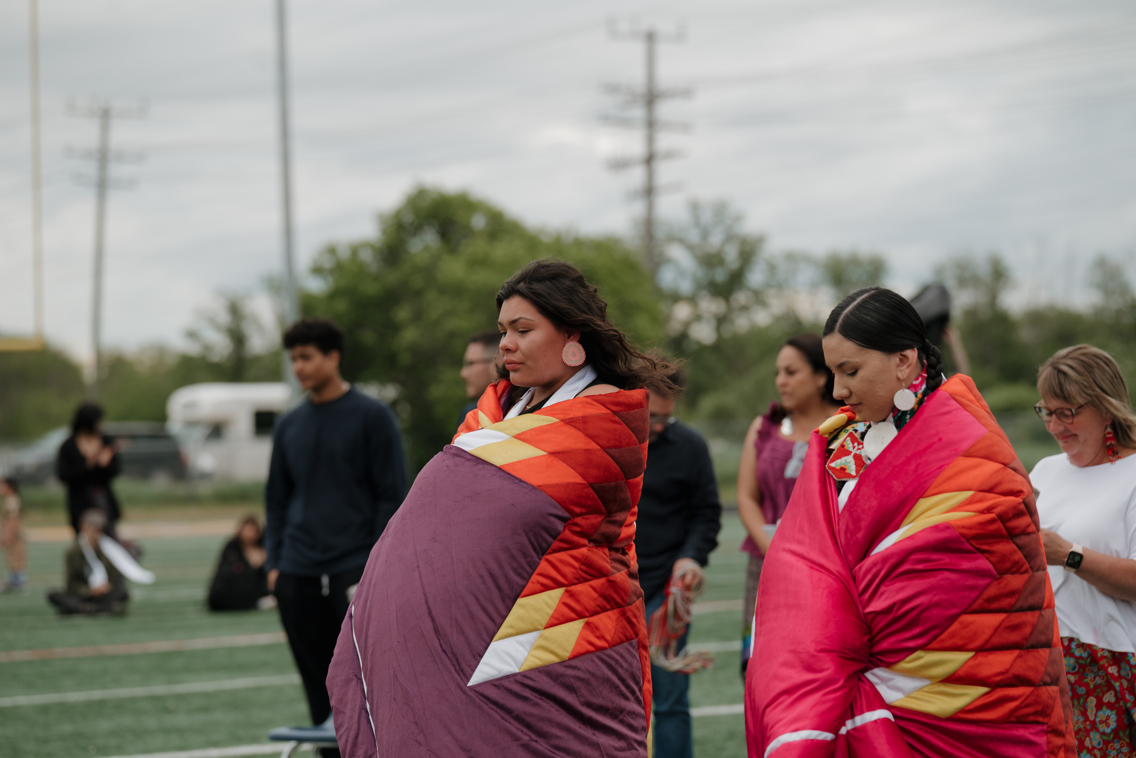
Land Acknowledgement
The Louis Riel School Division (LRSD) brings together a community of schools on the traditional land of the Anishinaabeg, Ininewak, and Dakota. Our division is located on the National Homeland of the Red River Métis. We recognize that Manitoba is also the traditional land of the Anishininiwak and Dene.
We respect the treaties made on this land and acknowledge the harms and mistakes of the past and present. We dedicate ourselves to authentic alliances with Indigenous communities in a spirit of reconciliation and cooperation.
We recognize and honour Shoal Lake 40 First Nation, the source of Winnipeg’s life-sustaining drinking water, as well as the Treaty Territories that generate and provide the electricity that powers daily activity throughout the province and beyond.
The ongoing development of LRSD's land acknowledgement is guided by our Indigenous Council of Grandmothers and Grandfathers, and we thank them for their generosity and collaboration.
Notes:
Jeff

Slide 3

Welcome and Introduction of Staff
Notes:
Chacun se présente et présente son équipe

Slide 4
What Are the Middle and Late Immersion Programs in LRSD?
They are intensive, accelerated programs intended for students who are interested and motivated to learn French as an additional language.
They are 3-year programs.
After three years, students will be prepared to successfully integrate into a French Immersion class in their catchment school.
Notes:
Carole

Slide 5


The Benefits of Being plurilingual
1. Cognitive Advantages
Improves memory and problem-solving skills.
Enhances creativity and adaptability.
Facilitates additional language acquisition
2. Academic Success
Strengthens literacy and language learning skills.
Facilitates the understanding of complex concepts.
3. Cultural Awareness
Promotes appreciation of different cultures and perspectives.
Builds empathy and global-mindedness.
Encourages meaningful cross-cultural connections.
4. Career Opportunities
Increases employability in a globalized job market.
Opens doors to international assignments and roles.
Strengthens communication with diverse clients and colleagues.
5. Personal Growth
Boosts confidence and adaptability in new situations.
Deepens self-awareness through multilingual identity.
Notes:
Cam

Slide 6
Outline of the Grade 4 Program
Emphasis of the Grade 4 program:
sound and vocabulary acquisition;
language development and fluency in speaking and listening;
first stages and development of literacy (reading and writing) in
French;
MI students have physical education, music and recess like all other
students in the school and that all classes are conducted in French;
Mathematics vocabulary and fundamentals until December such as
place value, addition and subtraction;
Grade 4 Math curriculum, Social Studies and Science are
implemented after winter break once students are feeling more
confident with the French language;
There is no formal English taught during this school year.
Notes:
Melody
sound and vocabulary acquisition;
language development and fluency in speaking and listening;
first stages and development of literacy (reading and writing) in French;
MI students have physical education, music and recess like all other students in the school and that all classes are conducted in French;
Mathematics vocabulary and fundamentals until December such as place value, addition and subtraction;
Grade 4 Math curriculum, Social Studies and Science are implemented after winter break once students are feeling more confident with the French language;
There is no formal English taught during this school year.

Slide 7
Outline of the Grade 5 Program
Emphasis of the Grade 5 program:
students communicate (read, write, speak and represent) in French from the very first day of school;
continuation of the objectives taught in Grade 4 with an increased focus on the development of literacy (reading) in French;
English Language Arts and Social Studies instruction begins in September;
Science is introduced by the second term;
due to the focus of language acquisition in Grade 4, topics that were not covered will be explored in Grade 5.
Notes:
Charla

Slide 8

Outline of the Grade 6 Program
Emphasis of the Grade 6 program:
continuation of the objectives taught in Grade 5;
increased focus on the development of writing in French;
further preparing students to successfully integrate into a regular Grade 7 French Immersion class by the end of Grade 6.
Notes:
Stephanie et Ally

Slide 9
Late Immersion (Grade 6 entry point)
Supporting Rapid Language Acquisition
A specialized program designed for students entering French Immersion at Grade 6.
Focused on developing the foundational vocabulary and language skills required to support learning across all subject areas.
Key Features:
Intensive Language Development: Daily instruction emphasizes oral communication, reading, and writing in French.
Vocabulary Building: Targeted strategies to accelerate the acquisition of academic and social vocabulary.
Mirroring Grade 4 Entry: Aligns with the pedagogical approaches of earlier immersion entry points, adapted for older learners.
Three-Year Pathway to Success
A carefully designed curriculum ensures students:
Close Gaps: Achieve linguistic and academic milestones to realign with peers.
Build Confidence: Develop skills to fully participate in immersion programming.
Prepare for High School: Transition seamlessly into Grade 9 Immersion courses alongside lifelong immersion learners.
Notes:
Jenn/Evelyn

Slide 10

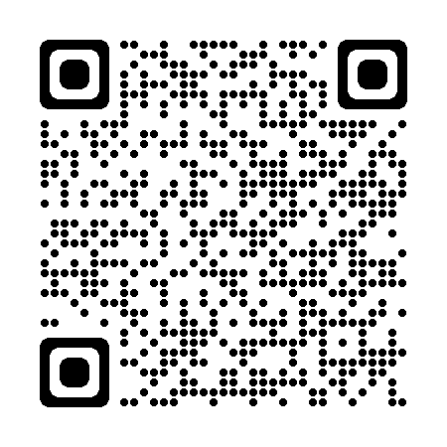
Middle Immersion in LRSD
Notes:
Patrice
Let’s take a moment to watch this brief video with testimonials from middle immersion students.

Slide 11
Family and Student testimonials
We have the pleasure of hearing testimonials from a Grade 4 École Henri-Bergeron parent accompanied by her daughter, former Middle Immersion student, along with a Grade 6 late immersion student from École Van Belleghem.
Notes:
Patrice présente le parent (Mary) et sa fille (Angel) et Jenn présente l’élève de École Van Belleghem.

Slide 12

FRequently Asked Questions
Is Middle Immersion a good fit for my child?
What will the homework routine look like?
What is my role as a parent of a student in the Middle Immersion Program?
What if I don't speak French?
What if my child doesn't like the program and wants to return to his/her previous school?
What about extended absences or family travel?
How can I be sure that my child can get his/her needs met if the teacher only speaks in French?
What are the arrangements for divisional transportation?
Is there a daycare?
Notes:
Carole
Some of the attributes middle or late immersion students usually possess are: – a predisposition for language learning, including strong English skills or knowledge of another language; – a strong interest to learn French; – maturity; – strong study skills and work habits; – a willingness to take risks and enjoy a challenge; – a tolerance for change and ambiguity; and – a good sense of humour.
Practice, reviewing concepts that have already been explored in the classroom together, listening to songs, TV episodes, following recipes, reading texts that have already been taught in class or at the student’s skill level.
To be supportive, to help create routines and space at home that allow for your child to complete simple homework and reading assignments, to listen to French music or to watch brief, simple French TV episodes.
In general, the French immersion program is designed specifically for students whose parents do not speak French and who themselves do not already speak French.
This is a very rare occurrence; our staff is here to support you and your child.
Extended absences or family travel will slow the language acquisition process and require your child to work doubly hard upon their return to school to narrow the gap.
The MI teaching staff, and other school staff as well, are experienced in supporting students and in gauging when the child requires specialized treatment to deal with a moment of anxiety or frustration.
Divisional transportation is provided.
EJR houses a separate YMCA daycare, which is not related to the school. You may choose to add your name to the wait list.

Slide 13
Transition to grade 7 (From Middle Immersion) and to grade 9 (from Late IMmersion)
Middle Immersion:
Once students complete Gr. 6 Middle Immersion, they join Early Immersion students (those who began in KG or Gr. 1) in their catchment school.
Late Immersion:
Once students complete Gr. 8 Late Immersion, they join the French Immersion High School of their catchment area, Collège Béliveau or Collège Jeanne-Sauvé.
Notes:
Patrice (Middle Immersion) Jenn(Late Immersion)

Slide 14
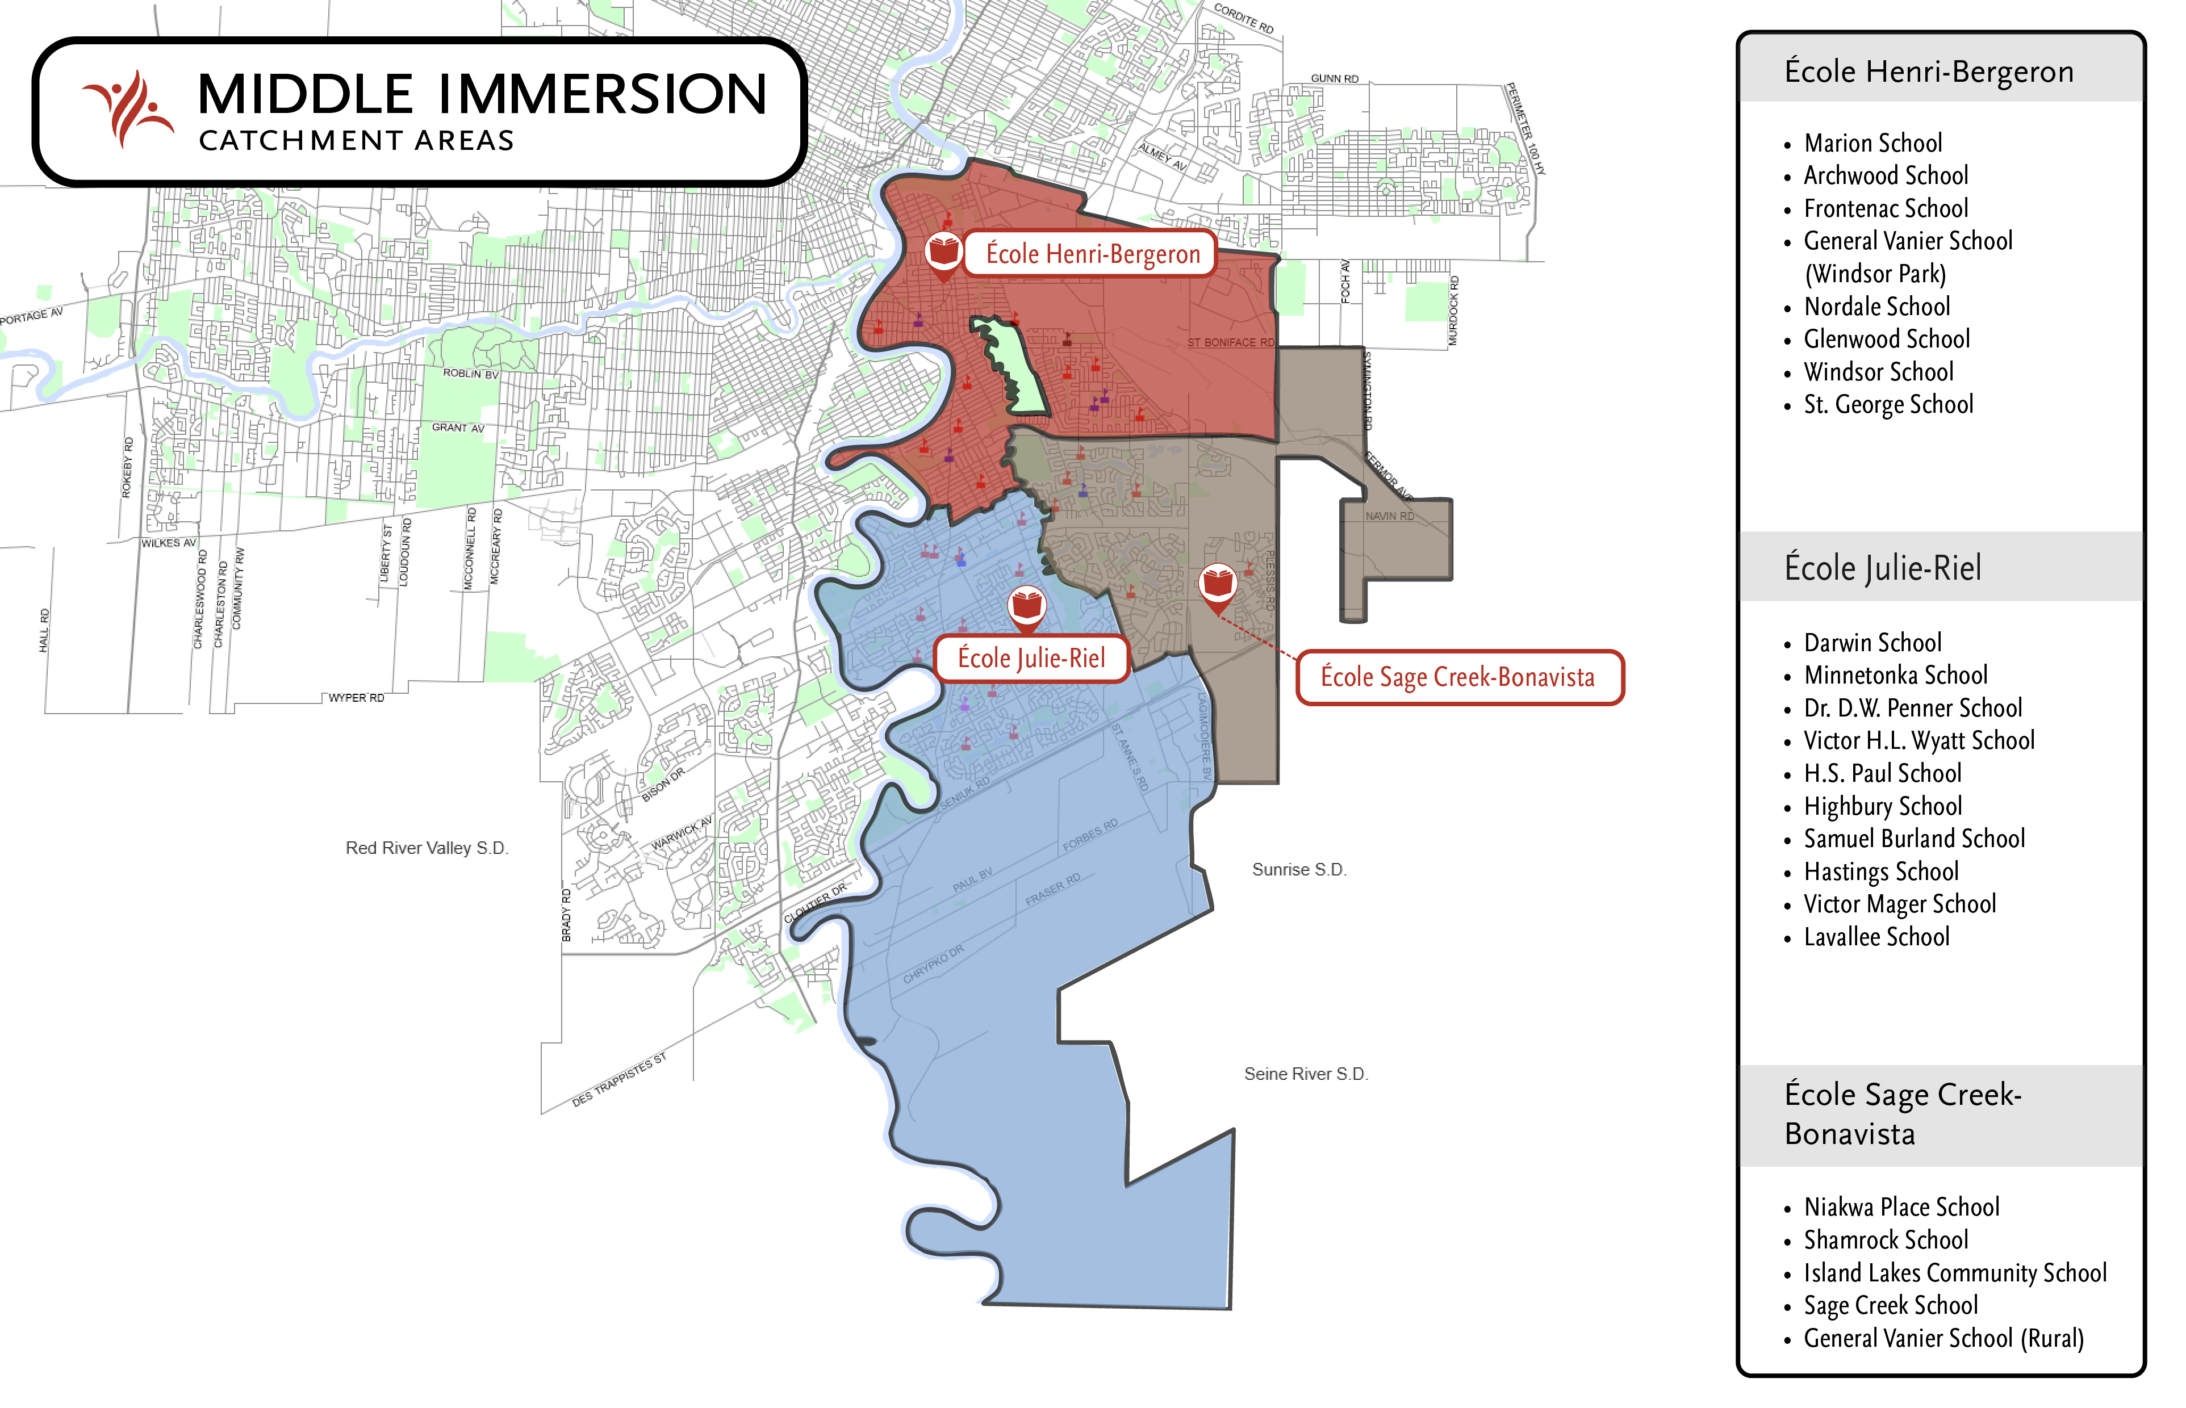
Notes:
Jeff

Slide 15
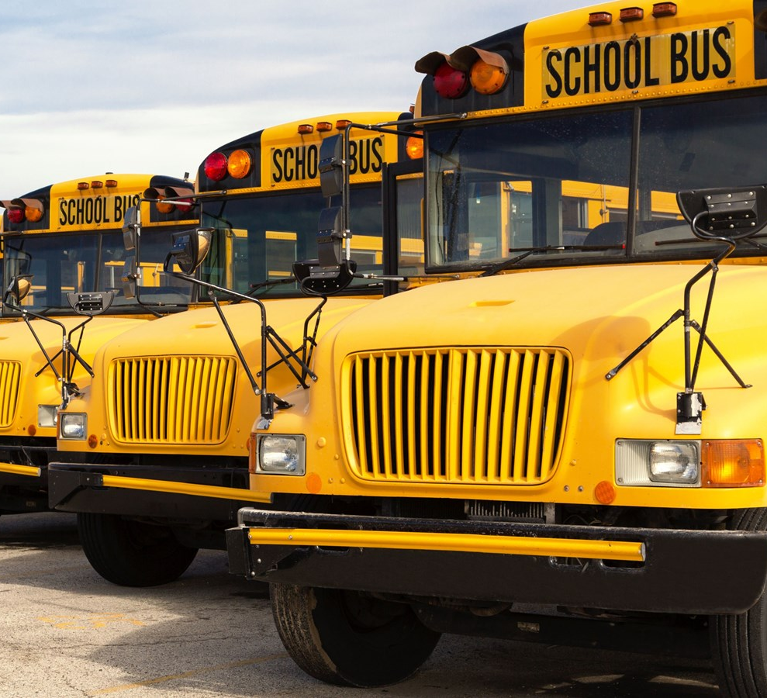
Transportation
In catchment:
Transportation provided for students in Grade 4-6 who live further than 1.6 km of the school
Grade 7 & 8 transportation is available as a paid seat option
Out of catchment:
Transportation is the responsibility of the family
Notes:
Jeff

Slide 16
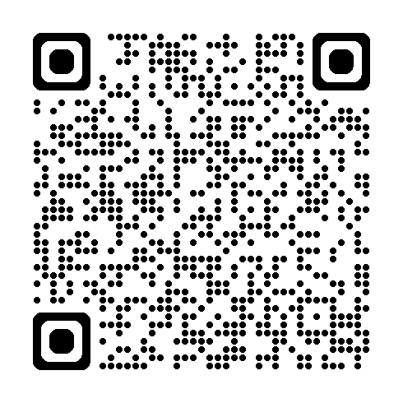
Brochure: Middle & LAte Immersion Programs
Notes:
Carole
You can scan this QR code for more information or find it on the website.

Slide 17
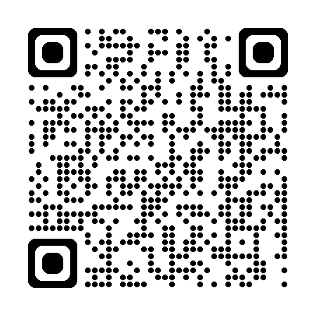

Next steps
Registration is done via the LRSD website and is now open. Applications will go directly to the school. Given capacity constraints, submitting this registration form will not guarantee final enrolment.
Keep spreading the word to your family and friends.
Notes:
Patrice (Date d'ouverture à confirmer). Nouveau processus à clarifier.

Slide 18
Merci!
We look forward to your child’s language learning journey!
Notes:
Cam
Thank you all for your attention and engagement throughout this presentation. This evening, we've had the opportunity to delve into some the details of our program.
As we conclude, I want to emphasize that our program is a very successful collective endeavor that thrives on the commitment, dedication and enthusiasm of each student.
I encourage you to continue the dialogue beyond this room in making your decision, but we will gladly answer any questions you may have at this time as a group or you could chosoe to speak to any of individually as we move to the classrooms.

